Slide 1
Functions

Slide 2
Function Review
Remember that functions have the following format:
return_type function_name(parameter_list);
To use function properly, you need to complete the following:
1. function declaration:
2. Call the corresponding function (Remember, when you call the function, number and type of argument has to match the number and type of parameter)
3. Function implementation

Slide 3
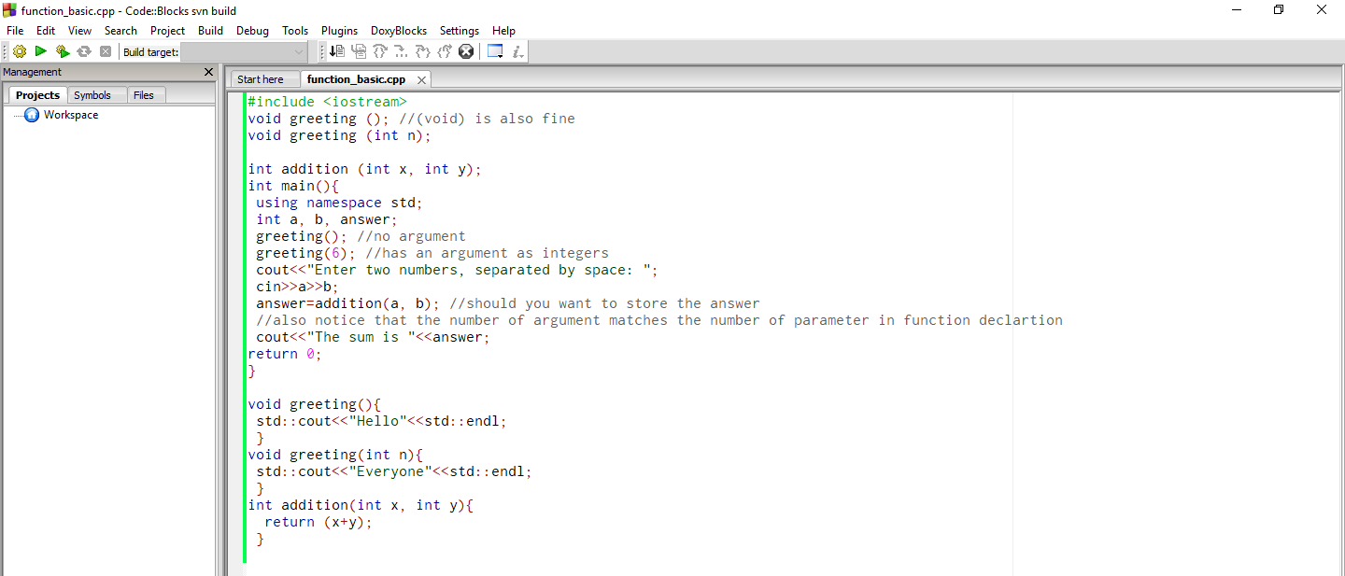
Example

Slide 4
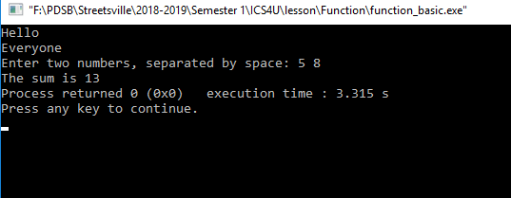
Output

Slide 5
Function Overloading
From the previous example, you can see there are two functions with the same name, but with different number of parameters
void greeting ();
void greeting (int n);
C++ allows this to happen. This feature is called function overloading, thus programmers can deploy functions with the same name. However, parameters need to be different

Slide 6
More of function overloading
The following will also work for function overloading
int addition (int x, float y);
float addition (float x, int y);
But the following wont’ be allowed:
int addition (int x, float y);
float addition (int x, float y); //

Slide 7
Recursive Function
Recursive function is basically a way of defining something in terms of itself.
For example, imagine you have a present wrapped by many layers. Therefore, the steps to take out the present would be the following
Unwrap one layer
If you find the present, you are done
Else, Unwrap one layer

Slide 8
Example
Should you have to find a term value of the following recursive formula
T₁=3
T_{n}=T_{n-1} +2; n>1
One way to implement it with the use of recursive function is the following

Slide 9
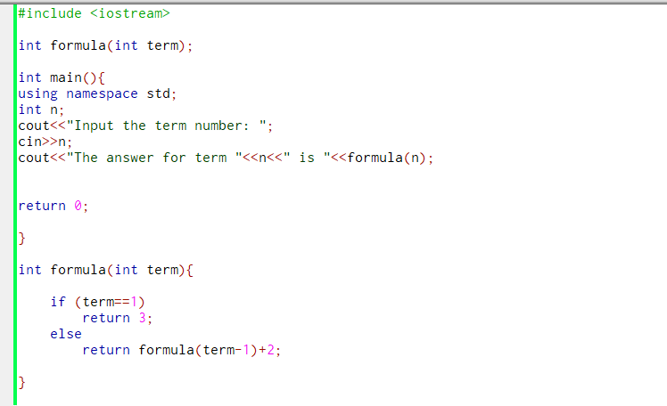

Slide 10
Explanation
Let’s say term is 3
It will run the line return formula(2)+2;
Now term is 2
It will run the line return formula(1)+2;
Now term is 1
When term is 1, it will return the value of 3
Then the line formula(1)+2 will become 3+2, which is 5
Formula(2)+2 will now become 5+2, so the final answer is 7

Slide 11
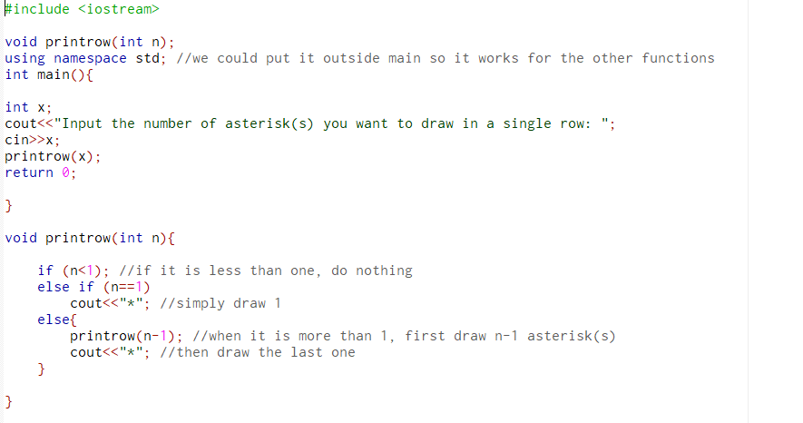

Slide 12
